Slide 1


Deep Learning for Brain-to-Text Decoding
Advance Machine Learning - Final Presentation
Presented by: Vidushi Villyal
Instructor: CJ Wu
December 4th, 2025

Slide 2
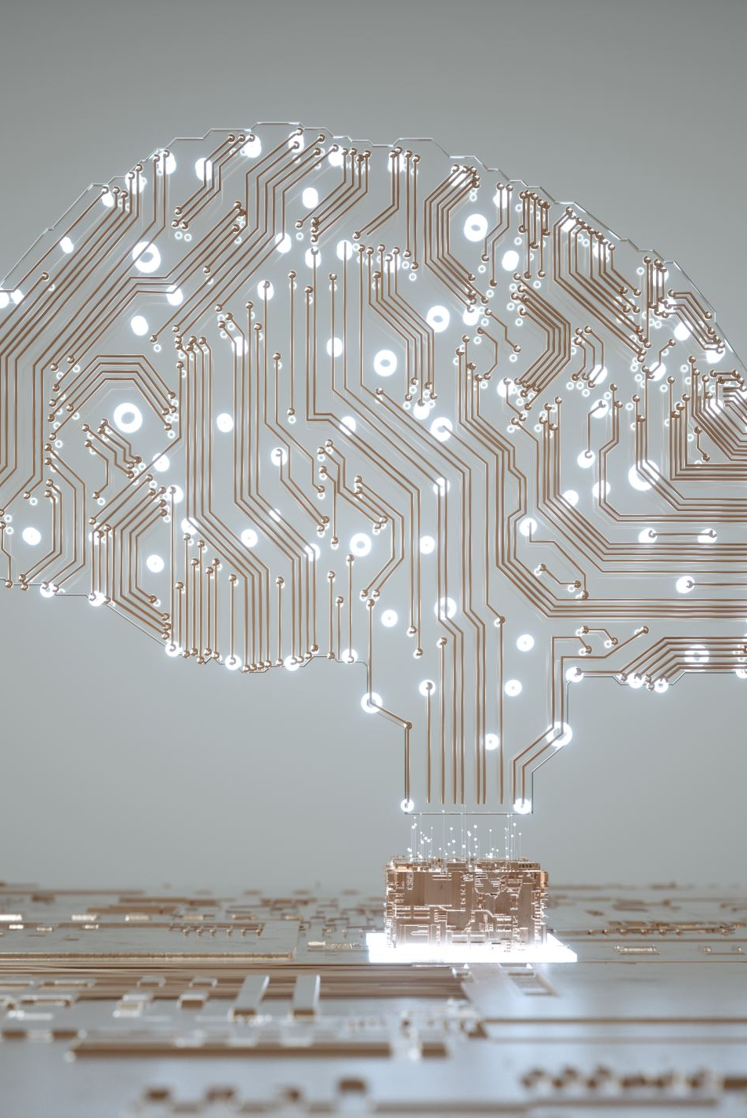
What Is Brain-to-Text Decoding?
Brain-to-text decoding is a technology that translates brain signals into written text. It uses patterns from electrical or magnetic brain activity to figure out what a person intends to say, even if no sound is produced.
This field is becoming crucial for people who cannot speak due to paralysis, stroke, ALS, or neurological damage.

Slide 3
Why This Topic Matters
Millions of individuals rely on slow assistive tools like eye-tracking or letter by letter selection. Brain-to-text decoding can give them something closer to natural communication.
Beyond medical use, this research also helps us understand how the brain organizes speech, meaning, and thought.

Slide 4
How Deep Learning Fits In
Brain signals are messy, unpredictable, and extremely complex. Deep learning models are good at spotting patterns in complicated data, which makes them ideal for decoding neural activity.
The goal: Learn the relationship between brain signals → words → full sentences.
Deep learning now outperforms every traditional method in this task.

Slide 5
Key Deep Learning Models Used
Convolutional Neural Networks (CNNs): Capture spatial patterns from electrodes and help identify speech-related activation.
RNNs / LSTMs / GRUs: Handle time-based brain patterns and decode the sequence of imagined or attempted speech.
Transformers: Currently the best. They process whole sequences at once and use attention to extract the most meaningful brain activity.
Generative Models: Help fill missing brain signal segments and improve decoding with small datasets.

Slide 6
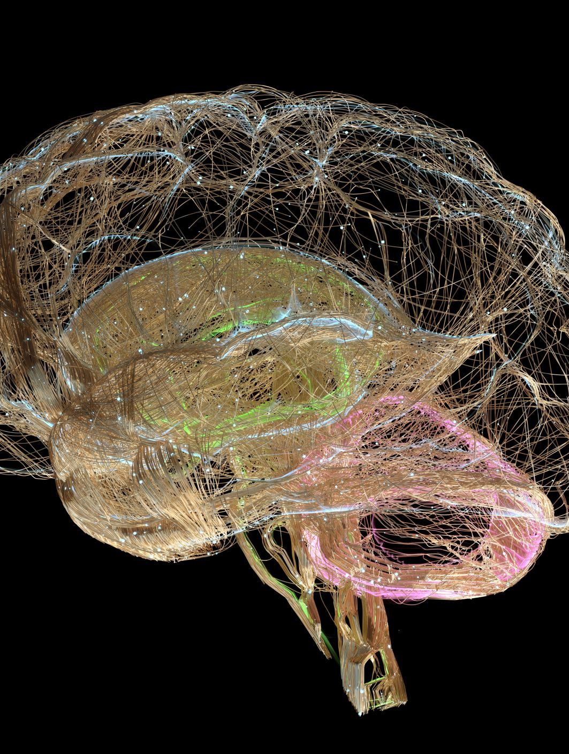
Breakthrough Research That Pushed the Field Forward
1. Stanford (2023–2024):
Used intracortical signals + Transformers
Reached 62 words per minute
Closest performance to natural typing so far
2. UCSF (BRAVO Project):
Decoded entire sentences from brain activity
Achieved ~15 WPM in paralyzed individuals
3. Meta AI (2023):
First strong non-invasive decoder using MEG
Reconstructed meaning from brain activity without surgery
These breakthroughs show rapid progress toward real-world communication tools.

Slide 7
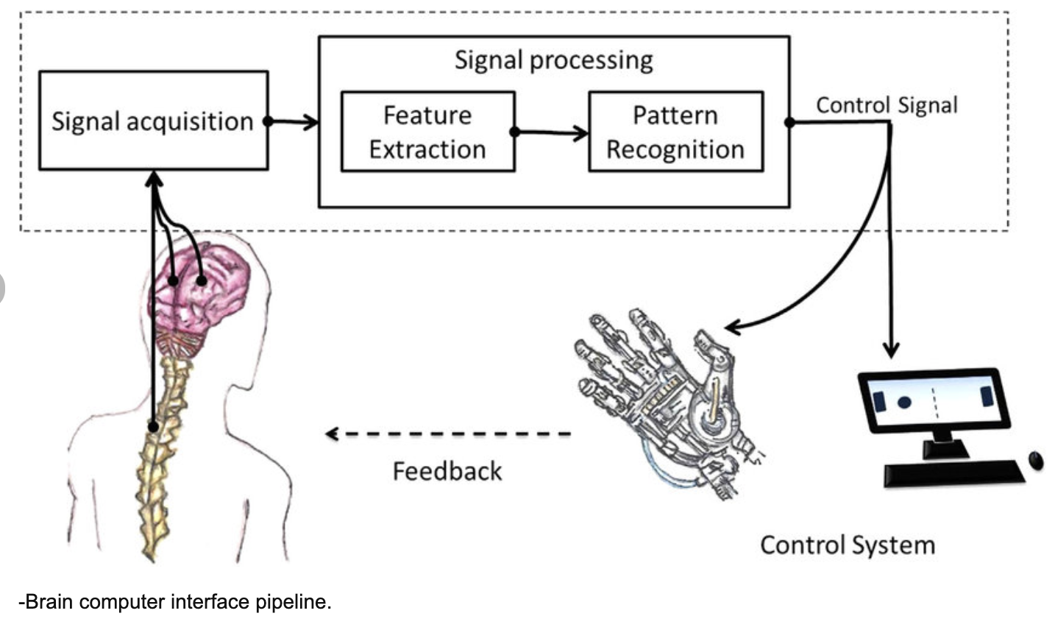
Real-World Applications
1. Healthcare:
Restores communication for patients unable to speak
Useful for stroke rehab and ALS support
2. Human Computer Interaction:
Thought-controlled devices
AR/VR systems guided by mental intent
3. Transport & Safety:
Driver alertness monitoring
Hands-free control systems for disabled users
4. Security:
Brain-based identification (brainprints) – but with ethical concerns

Slide 8


Challenges Holding Back the Technology
Despite major progress, several challenges remain:
Brain signals vary a lot between individuals
Datasets are extremely small and hard to collect
Non-invasive methods like EEG have low resolution
Models require very low latency for real-time use
Privacy concerns (mind reading without consent)
These issues make widespread deployment difficult right now.

Slide 9
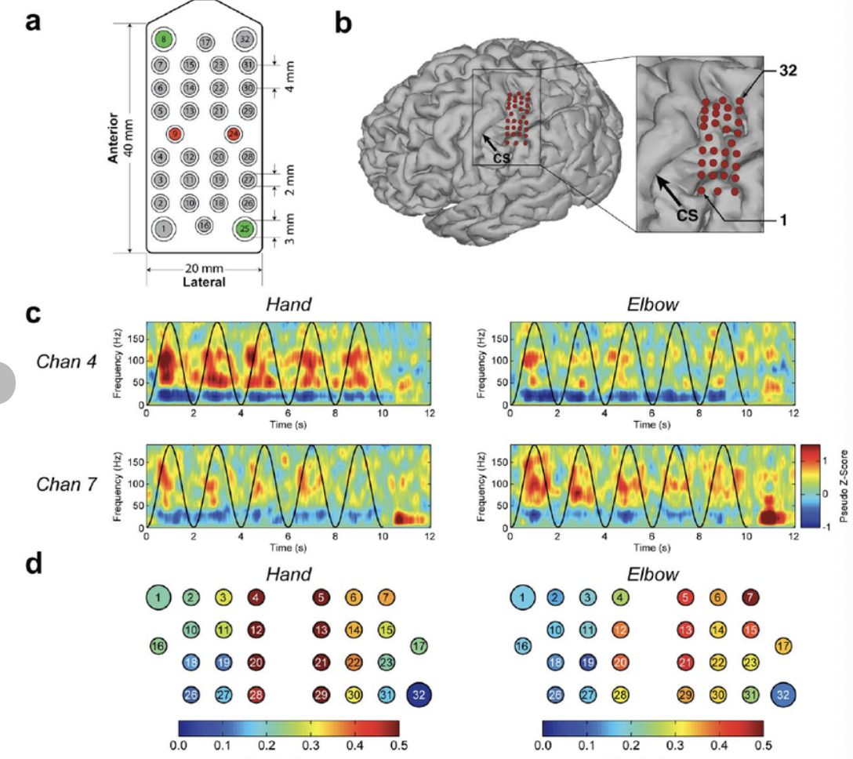
Evaluation of the Model
The model was tested on imagined and attempted speech tasks.
Performance Summary:
WER: 38–45%
CER: 15–20%
Latency: ~200 ms
Attempted speech produced more stable neural patterns, leading to higher accuracy. Although non-invasive models lag behind invasive systems, results are promising for safe and scalable communication tools.

Slide 10

Conclusion
Brain-to-text decoding is moving from research labs toward real-world impact. As sensors improve and deep learning models evolve, we may soon see fluent, natural communication directly from brain activity.
This technology has the potential to:
Give a voice to people who cannot speak
Transform human-AI interaction
Deepen scientific understanding of language in the brain
The future of communication may truly begin inside the mind.

